Slide 1
1. Environmentalism
Topic 4. Environmentalism
Chapter 1. Business Basics.
Unit 1. The Context of Business.
MXA101 – Introduction To Business
-By ManageX Academy

Slide 2
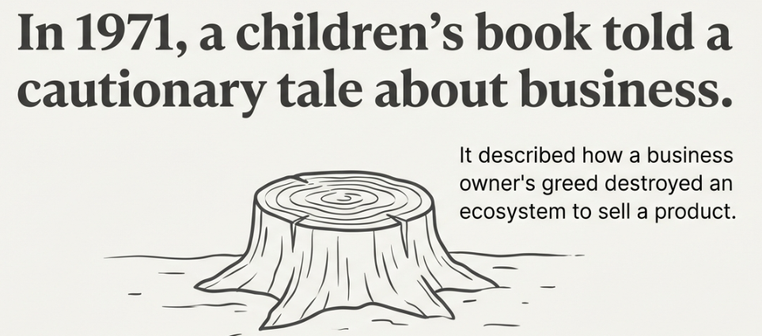
Environmentalism & Business – Why It Matters Today
Meaning of environmentalism in a business context
Shift from profit-only mindset to responsible growth
Rising pressure from customers, regulators, and society
Environment as a strategic business concern

Slide 3
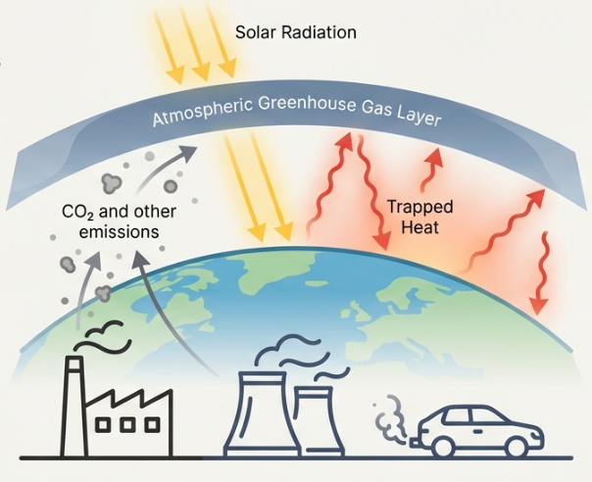
Evolution of Business Thinking
Traditional view: Profit over everything
Modern view: Profit with responsibility
Role of awareness, activism, and global challenges
Sustainability as a long-term survival strategy

Slide 4
Land Pollution – A Hidden Business Cost
Industrial waste dumping and landfills
Impact of mining, deforestation, and urban expansion
Loss of biodiversity and fertile land
Long-term economic and social consequences

Slide 5
Business Responsibility in Land Protection
Waste reduction and responsible disposal
Sustainable sourcing of raw materials
Balancing economic growth and environmental protection
Role of government, businesses, and local communities

Slide 6
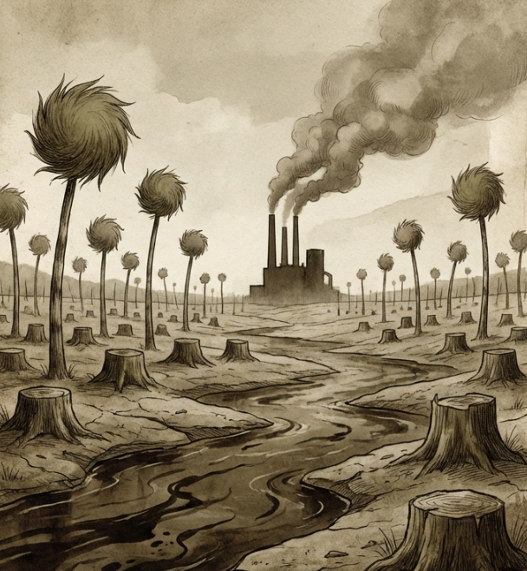
Air Pollution – When Growth Chokes the Planet
Emissions from factories, vehicles, and power plants
Impact on public health and productivity
Link between carbon emissions and climate change
Business contribution to global warming

Slide 7
How Businesses Can Reduce Air Pollution
Energy-efficient manufacturing and logistics
Shift to renewable and clean energy
Innovation in green technology
Compliance turning into competitive advantage

Slide 8
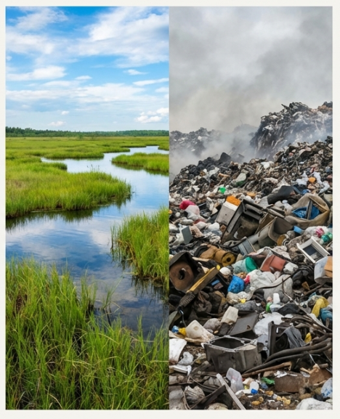
Water Pollution – The Business Risk No One Sees
Industrial discharge and chemical dumping
Agricultural runoff and untreated sewage
Scarcity of clean water affecting operations
Rising cost of water-related crises

Slide 9
Corporate Role in Water Conservation
Efficient water usage in operations
Wastewater treatment and reuse
Collaboration with government and NGOs
Educating consumers and communities

Slide 10
What Is Sustainability in Business?
Definition of sustainability
Meeting present needs without harming future generations
Sustainability as value creation, not charity
Integration into core business strategy

Slide 11
Sustainability in Action – Corporate Examples
Green buildings and energy-efficient offices
Responsible supply chains
Circular economy practices
Sustainability projects linked to profitability

Slide 12
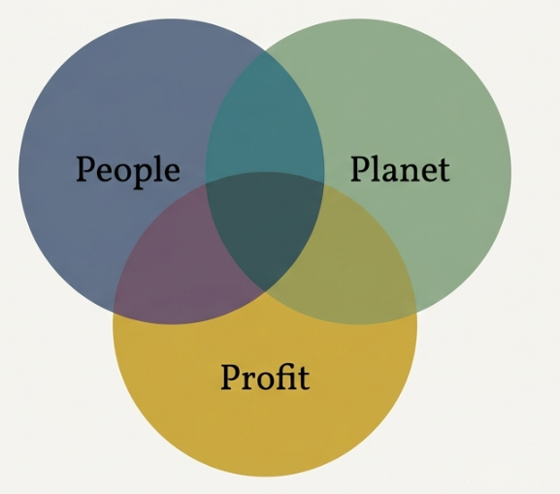
Triple Bottom Line – A New Performance Lens
Limitations of profit-only measurement
Three dimensions: Profit, People, Planet
Stakeholder-focused business evaluation
Reporting beyond financial statements

Slide 13
Environmentalism as a Competitive Advantage
Brand trust and customer loyalty
Cost savings through efficiency
Talent attraction and retention
Long-term resilience and growth

Slide 14
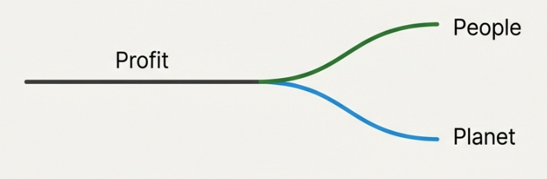
Key Takeaways for Future Managers
Environmental responsibility is unavoidable
Sustainability and profitability can coexist
Managers must think long-term
Smart businesses protect both planet and profit

Slide 15


